Slide 1













ElectriCuria
Ilirjana Hyseni
University of Texas
Postgrad in Data Science
Mishel García Vela
Rice University
Masters in Engineering Management
Lokesh Peta
Oklahoma State
Masters in Computer Science
Christopher Wagner
University of Michigan
Bachelors in Computer Science
Pranjal Sheth
University of Houston
Bachelors in Finance & Accounting
Notes:
Ni-H : High PSI, increasing energy density, no heating issues because can handle extreme temperatures seen through NASA experiments, no thermal runaway, though hydrogen is flammable, it dissipates quickly to non-flammable concentrations when it escapes confinment and that can be arranged, it is also way less ambient than hydrocarbon or lithium fires. Batteries are low maintenance or maintenance free because there are small dendrite formations that usually happen for batteries on their anodes during charging causing degredation, however it is not there for this battery. Non-toxic chemicals because they are basic chemicals. Cons: Biggest issue is that these are not cost competitive at all, they are super costly in comparision to other batteries
Source:
(2). https://undecidedmf.com/why-this-nasa-battery-may-be-the-future-of-energy-storage/
Battery Cycle for SSB: Backward calculation from data in https://www.topspeed.com/solid-state-batteries-important-for-electric-vehicles/#:~:text=Some%20more%20advanced%20solid%2Dstate,before%20showing%20signs%20of%20degradation.
Flywheel rated power output: https://www.azom.com/article.aspx?ArticleID=17336#:~:text=Flywheels%20are%20best%20suited%20to,are%20two%20basic%20flywheel%20configurations.
Flywheel Degradation: https://www.outlookindia.com/website/story/outlook-spotlight-flywheel-energy-storage-india-amber-kinetics-the-industry-leader/409238
Pros for Lithium :
Solid-State Batteries Energy Density: https://www.dnv.com/to2030/technology/are-solid-state-batteries-the-holy-grail-for-2030.html

Slide 2




Problem
Challenge 1:
Create a forecast for ERCOT’s long-term load and renewable capacity/generation until December 2028, understand, quantify, and qualify the reason for difference
Challenge 2:
You have now created a thesis for load and renewable generation and have hourly forecasts for both, now deploy a technology that you can use to generate alpha both in times of cheap renewable energy and high load. Understand the different possible solutions and pick the one that makes the most sense with your strategy
Challenge 3:
You have now figured out there are inefficiencies in the market, and that an efficient technology can help you provide physical solutions. Now locate the most effective location for placement of your asset that allows for a repeated power advantage with least inter-transmission costs.
Problem
ERCOT Forecast
Energy Storage Solutions
ERCOT Locational Analysis
Appendix
Notes:
Ni-H : High PSI, increasing energy density, no heating issues because can handle extreme temperatures seen through NASA experiments, no thermal runaway, though hydrogen is flammable, it dissipates quickly to non-flammable concentrations when it escapes confinment and that can be arranged, it is also way less ambient than hydrocarbon or lithium fires. Batteries are low maintenance or maintenance free because there are small dendrite formations that usually happen for batteries on their anodes during charging causing degredation, however it is not there for this battery. Non-toxic chemicals because they are basic chemicals. Cons: Biggest issue is that these are not cost competitive at all, they are super costly in comparision to other batteries
Source:
(2). https://undecidedmf.com/why-this-nasa-battery-may-be-the-future-of-energy-storage/
Battery Cycle for SSB: Backward calculation from data in https://www.topspeed.com/solid-state-batteries-important-for-electric-vehicles/#:~:text=Some%20more%20advanced%20solid%2Dstate,before%20showing%20signs%20of%20degradation.
Flywheel rated power output: https://www.azom.com/article.aspx?ArticleID=17336#:~:text=Flywheels%20are%20best%20suited%20to,are%20two%20basic%20flywheel%20configurations.
Flywheel Degradation: https://www.outlookindia.com/website/story/outlook-spotlight-flywheel-energy-storage-india-amber-kinetics-the-industry-leader/409238
Pros for Lithium :
Solid-State Batteries Energy Density: https://www.dnv.com/to2030/technology/are-solid-state-batteries-the-holy-grail-for-2030.html

Slide 3

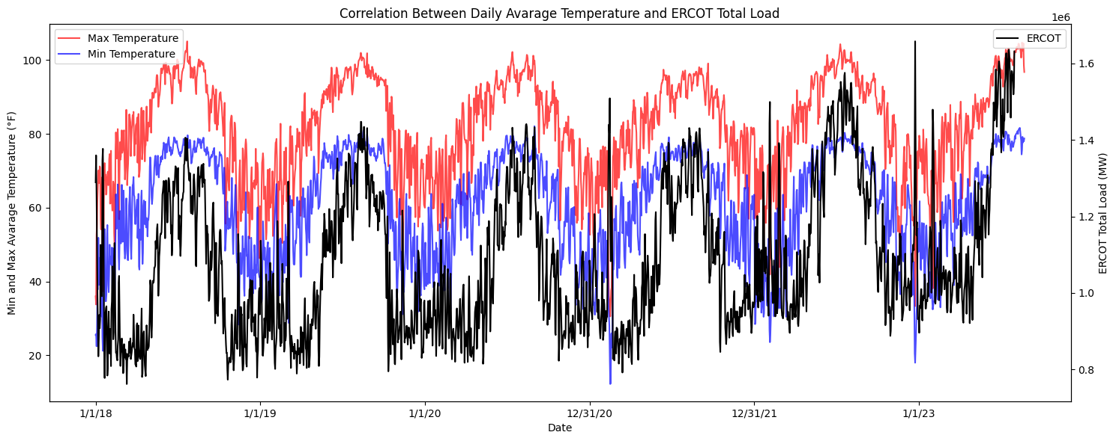
ERCOT Forecast
(GW)
Summer Peak days load Comparision
load
year
Problem
ERCOT Forecast
Energy Storage Solutions
ERCOT Locational Analysis
Appendix
Notes:
Ni-H : High PSI, increasing energy density, no heating issues because can handle extreme temperatures seen through NASA experiments, no thermal runaway, though hydrogen is flammable, it dissipates quickly to non-flammable concentrations when it escapes confinment and that can be arranged, it is also way less ambient than hydrocarbon or lithium fires. Batteries are low maintenance or maintenance free because there are small dendrite formations that usually happen for batteries on their anodes during charging causing degredation, however it is not there for this battery. Non-toxic chemicals because they are basic chemicals. Cons: Biggest issue is that these are not cost competitive at all, they are super costly in comparision to other batteries
Source:
(2). https://undecidedmf.com/why-this-nasa-battery-may-be-the-future-of-energy-storage/
Battery Cycle for SSB: Backward calculation from data in https://www.topspeed.com/solid-state-batteries-important-for-electric-vehicles/#:~:text=Some%20more%20advanced%20solid%2Dstate,before%20showing%20signs%20of%20degradation.
Flywheel rated power output: https://www.azom.com/article.aspx?ArticleID=17336#:~:text=Flywheels%20are%20best%20suited%20to,are%20two%20basic%20flywheel%20configurations.
Flywheel Degradation: https://www.outlookindia.com/website/story/outlook-spotlight-flywheel-energy-storage-india-amber-kinetics-the-industry-leader/409238
Pros for Lithium :
Solid-State Batteries Energy Density: https://www.dnv.com/to2030/technology/are-solid-state-batteries-the-holy-grail-for-2030.html

Slide 4
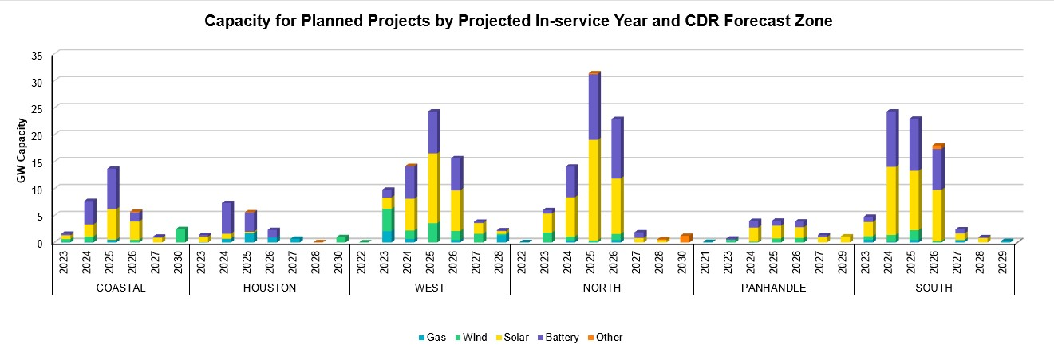
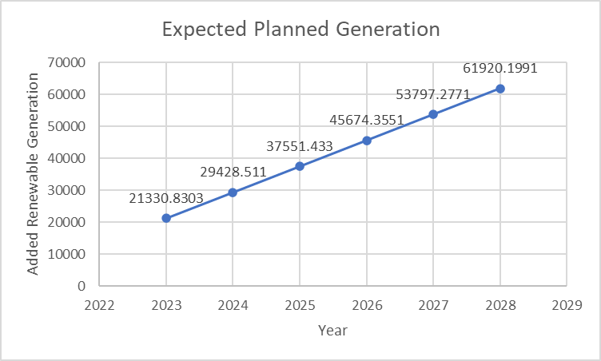
ERCOT Forecast
Problem
ERCOT Forecast
Energy Storage Solutions
ERCOT Locational Analysis
Appendix
Notes:
Ni-H : High PSI, increasing energy density, no heating issues because can handle extreme temperatures seen through NASA experiments, no thermal runaway, though hydrogen is flammable, it dissipates quickly to non-flammable concentrations when it escapes confinment and that can be arranged, it is also way less ambient than hydrocarbon or lithium fires. Batteries are low maintenance or maintenance free because there are small dendrite formations that usually happen for batteries on their anodes during charging causing degredation, however it is not there for this battery. Non-toxic chemicals because they are basic chemicals. Cons: Biggest issue is that these are not cost competitive at all, they are super costly in comparision to other batteries
Source:
(2). https://undecidedmf.com/why-this-nasa-battery-may-be-the-future-of-energy-storage/
Battery Cycle for SSB: Backward calculation from data in https://www.topspeed.com/solid-state-batteries-important-for-electric-vehicles/#:~:text=Some%20more%20advanced%20solid%2Dstate,before%20showing%20signs%20of%20degradation.
Flywheel rated power output: https://www.azom.com/article.aspx?ArticleID=17336#:~:text=Flywheels%20are%20best%20suited%20to,are%20two%20basic%20flywheel%20configurations.
Flywheel Degradation: https://www.outlookindia.com/website/story/outlook-spotlight-flywheel-energy-storage-india-amber-kinetics-the-industry-leader/409238
Pros for Lithium :
Solid-State Batteries Energy Density: https://www.dnv.com/to2030/technology/are-solid-state-batteries-the-holy-grail-for-2030.html

Slide 5
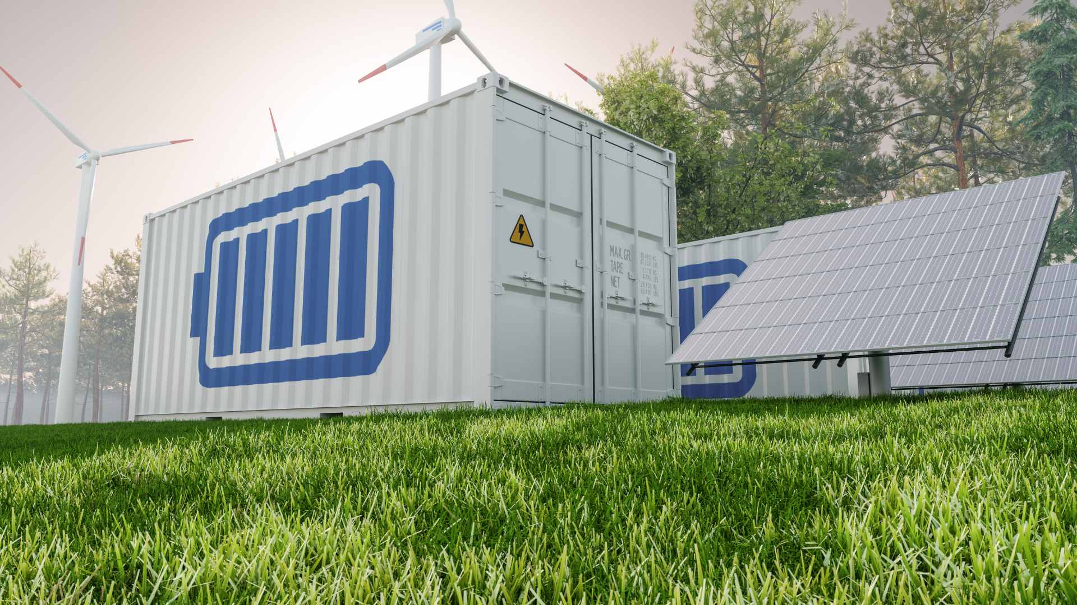
Energy Storage Solutions
 | Pros | Cons | Energy Density (Wh/kg) | Power Density (kW/m³) | Cost of Energy ($/kWh) | Rated power output (kW) | Rated Energy Capacity (kWh) | Battery Cycles (cycles) | Project Life (y) | Degrade (%)
Li–Ion Batteries | Prices expected to significantly decrease | Environmental Risks, REM | 260 | 50-800 | $265-358 | 965-2833 kW | 3720 | 3,000-10,000 | 20 | 2.6%
Ni-H Batteries² | No thermal runaway, low maintenance, non-toxic chemicals, no REM | - | 140 | 40-60 | $83-330 | 175 kW | 440 | 30,000 | 30 | -
Flywheel Storage | Fast power response | Safety concerns, not cost competitive | 50 | 1000-2000 | $150-250 | 100-2000 kW | - | >100,000 | 20 | .05%
Solid-State Batteries | Environmentally friendly, faster supply chain | Too early in the development stage, REM, not cost competitive | 650¹ | - | $85-400 | - | - | 50,000 | 30³ | -
Our proposed investment solution is Nickel Hydrogen Batteries near the Dallas County in ERCOT since we believe low cost of energy alongside higher battery cycles is more of the strategy we are aiming for
Utility-scale batteries can respond to load requirements within milliseconds versus conventional plants that can take up to minutes – allowing us to bridge inefficiencies in the market
Additional Storage Solutions were considering including Molten-Salt Batteries, Zinc-Bromide batteries, Vanadium batteries, and Iron-redox
Negligible Factors: End of life cost, carbon emission footprint, cycle efficiency, social acceptance
We understand that Mercuria has a large presence in investments in asset-based startup technologies and have identified Prieto Battery as a potential target that plays in the space of solid-state batteries which we believe to be promising
Source: NASA, Lazard, Undecided website, Reuters, Published Research
Notes: (1) Prediction based on estimated energy density multiper in comparison to Li-Ion; (2) EnerVenue has claimed to have tackled cost issue by substituting REM; (3) Estimated; REM = Rare Earth Metals
Problem
ERCOT Forecast
Energy Storage Solutions
ERCOT Locational Analysis
Appendix
Notes:
Ni-H : High PSI, increasing energy density, no heating issues because can handle extreme temperatures seen through NASA experiments, no thermal runaway, though hydrogen is flammable, it dissipates quickly to non-flammable concentrations when it escapes confinment and that can be arranged, it is also way less ambient than hydrocarbon or lithium fires. Batteries are low maintenance or maintenance free because there are small dendrite formations that usually happen for batteries on their anodes during charging causing degredation, however it is not there for this battery. Non-toxic chemicals because they are basic chemicals. Cons: Biggest issue is that these are not cost competitive at all, they are super costly in comparision to other batteries
Source:
(2). https://undecidedmf.com/why-this-nasa-battery-may-be-the-future-of-energy-storage/
Battery Cycle for SSB: Backward calculation from data in https://www.topspeed.com/solid-state-batteries-important-for-electric-vehicles/#:~:text=Some%20more%20advanced%20solid%2Dstate,before%20showing%20signs%20of%20degradation.
Flywheel rated power output: https://www.azom.com/article.aspx?ArticleID=17336#:~:text=Flywheels%20are%20best%20suited%20to,are%20two%20basic%20flywheel%20configurations.
Flywheel Degradation: https://www.outlookindia.com/website/story/outlook-spotlight-flywheel-energy-storage-india-amber-kinetics-the-industry-leader/409238
Solid State Cost of Energy: https://www.google.com/search?q=%24%2FkW+for+solid+state+batteries&rlz=1C1RXQR_enUS970US970&oq=%24%2FkW+for+solid+state+batteries&aqs=chrome..69i57j33i160l2j33i299j33i22i29i30l6.7698j0j1&sourceid=chrome&ie=UTF-8
Pros for Lithium :
Solid-State Batteries Energy Density: https://www.dnv.com/to2030/technology/are-solid-state-batteries-the-holy-grail-for-2030.html

Slide 6


ERCOT Location Analysis
Problem
ERCOT Forecast
Energy Storage Solutions
ERCOT Locational Analysis
Appendix

Slide 7
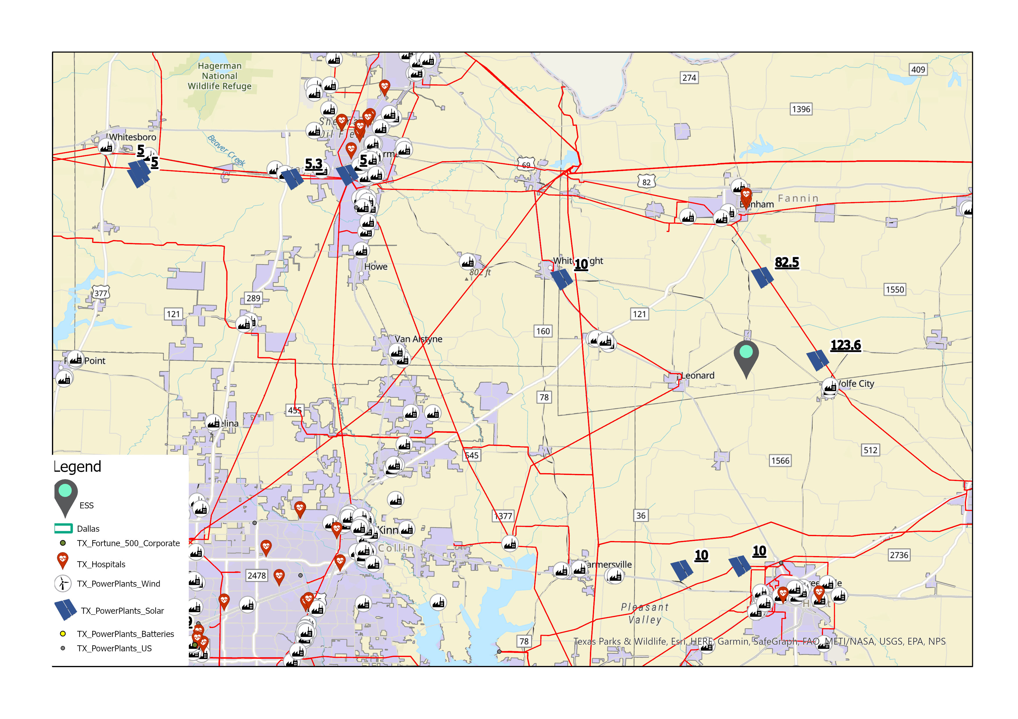
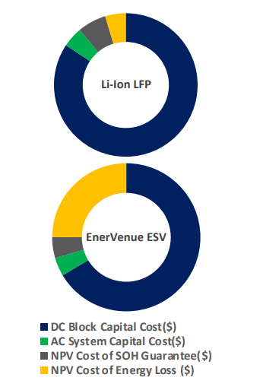
ERCOT Location Analysis
We have chosen to choose a location close to Dallas because of their high forecasted load demand that we supply to
We also considered the land cost of this region and have determined that we can find land for between $12-30 thousand per acre
Then for battery storage we believe placing it closest to site of generation would allow for least barriers to storage and have thus chosen a site close to a total of ~ 250 MW of solar generation and a wind-farm slightly further away¹ but providing another 180 MW
Source: NASA, Redfin, Texas Department of Transportation, EIA Atlas, HIFLD Open Data,
Notes: (1) 66 miles away versus 5 miles for closest solar
Problem
ERCOT Forecast
Energy Storage Solutions
ERCOT Locational Analysis
Appendix

Slide 8

Thank you & Q&A

Slide 9
Full-Zoom Locational Analysis
Problem
ERCOT Forecast
Energy Storage Solutions
ERCOT Locational Analysis
Appendix

Slide 10

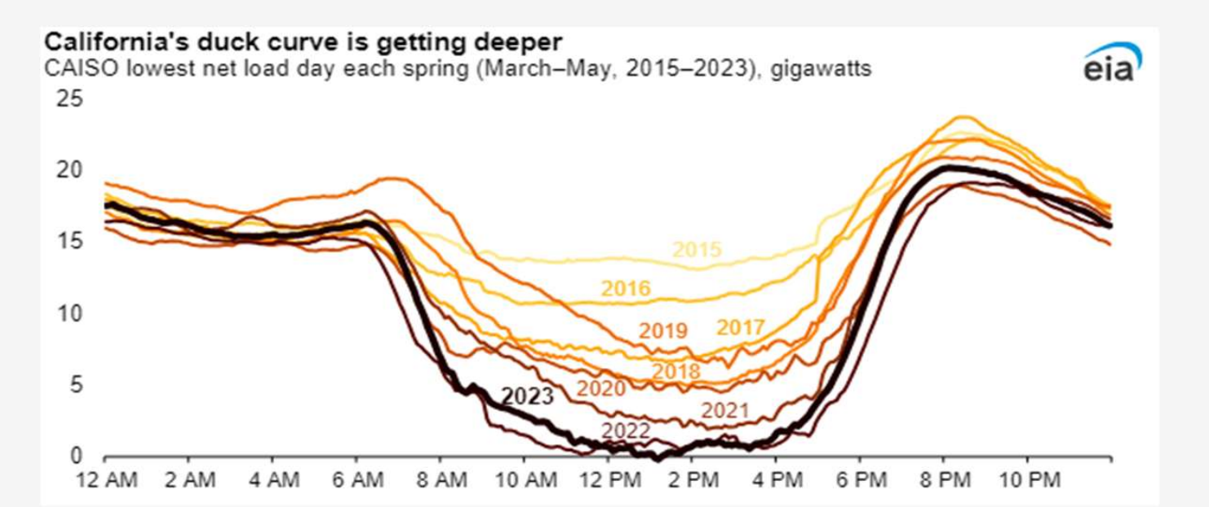
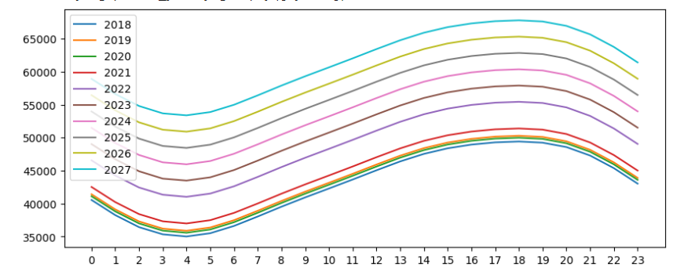
Duck Curve
Problem
ERCOT Forecast
Energy Storage Solutions
ERCOT Locational Analysis
Appendix

Slide 11
Duck Curve
Problem
ERCOT Forecast
Energy Storage Solutions
ERCOT Locational Analysis
Appendix

Slide 12
Operating & Maintenance Cost
Component Maintenance
Electrolyte Replacement
Hydrogen Supply
Cooling System Maintenance
Monitoring and Control Systems
Safety Measures
Labor Costs
Energy Consumption
Diagnostics and Testing
Waste Management
Site Maintenance
Training and Workforce Development
Unforeseen Repairs
Insurance
Downtime and Opportunity Costs
Problem
ERCOT Forecast
Energy Storage Solutions
ERCOT Locational Analysis
Appendix

